Slide 1

From Data to Decisions:
A Production-Ready ML Pipeline for Robust Loan Default Prediction
Lim Kai Zhuo
Nov 2025
Notes:
Author: Mark Nold
Website: https://marknold.substack.com
This template is intended to help future business leaders and consultants learn how to communicate better. It is available at marknold.substack.com
This template is released under Creative Commons By 4.0 Deed, which means
* You are free to Share and Adapt, but;
* You must give appropriate credit to the author and website.
eg: "Using Mark Nold’s template found at https://marknold.substack.com"
For further details on the Creative Commons By 4.0 Deed, please see https://creativecommons.org/licenses/by/4.0/

Slide 2
Executive Summary
End-to-end, production-ready ML pipeline featuring a robustly trained and tuned model for accurate, scalable, and governed credit-risk prediction.
Problem
Solution
Impact
Loan defaults have risen sharply, impacting profitability and increasing credit risk exposure.
Data scattered across multiple systems, inconsistent preprocessing, and manual model refreshes have made existing credit models unstable and slow to respond to new borrower behavior.
Without a unified and monitored pipeline, prediction accuracy declines over time, leading to poor credit decisions.
A fully automated Machine Learning Pipeline was built using Medallion Architecture, Docker, and Apache Airflow to manage the complete model lifecycle.
Process Data: Bronze–Silver–Gold layers standardize and clean raw financial, attribute, and behavioral data, creating validated, leakage-free features.
Develop Model: A 3-stage framework automates hyperparameter tuning, SHAP-based feature selection, and final model refinement to identify the best XGBoost model.
Deploy: The best model is stored in a centralized Model Registry and automatically scheduled by Airflow for monthly inference on new data snapshots.
Monitor: Continuous tracking of feature drift and AUC drift detects performance degradation; automated email alerts and governance rules trigger model retraining.
Accuracy: Achieved stronger predictive performance with improved model stability across time, enabling earlier and more accurate identification of high-risk or potential bad loans.
Efficiency: Streamlined data processing and retraining cycles, allowing faster and scalable deployment of refreshed models to keep predictions current with evolving borrower behavior.
Governance: Established transparent, auditable model management aligned with enterprise risk and regulatory standards, ensuring confidence and accountability in production decisions.
Business Value: Improved detection of default-prone borrowers reduces bad-loan approvals, safeguards credit portfolio quality, and enhances overall profitability through better risk-adjusted lending.
Notes:
Author: Mark Nold
Website: https://marknold.substack.com
This template is intended to help future business leaders and consultants learn how to communicate better. It is available at marknold.substack.com
This template is released under Creative Commons By 4.0 Deed, which means
* You are free to Share and Adapt, but;
* You must give appropriate credit to the author and website.
eg: "Using Mark Nold’s template found at https://marknold.substack.com"
For further details on the Creative Commons By 4.0 Deed, please see https://creativecommons.org/licenses/by/4.0/

Slide 3




Overall Architecture
End-to-end machine learning pipeline: from raw data ingestion to feature engineering, model tuning, deployment, and monitoring.
B
S
G
Initial
Tuning
MR
X
AUC
ETL
ETL
ETL
Bronze
Extract raw data from backend data source
Silver
Data cleaning of raw Bronze data
Gold
Feature engineering for new, insightful, and non-linear features
Model Registry
Stores the best XGB model after tuning
Feature Drift
Monitors distribution of reference vs new data with KS Statistical Test
SHAP Feature Importance
Silver Overview
Final Tuning + Feature Selection
Airflow
Schedule monthly inference on new snapshot data
(or manual trigger)
Prediction AUC Drift
Monitors new inference performance across time
Numerical: Outliers handling, null/ placeholder coercion, string to float/int cleaning
Categorical: Regular expression cleaning, binning, binary/indicator variables
(e.g. Type of loan split into 1 column for 0/1 for each loan type)
Imputation: Missing values fill with mean of group (e.g. NA salary filled with avg. of job)
Gold Overview
3 Stage Automatic
Hyperparameter + Feature Selection Framework
Email Alerts
Sends alert if model performance worsens
Ratio Metrics: Taking ratios of variables of absolute monetary values into new scale-independent financial ratios. E.g. Debt-to-income, Dept-per-loan, EMI-to-income
Non-linear Transformations: Log, squared, cubed
Threshold / Binning: Simplify continuous variables into bins or ordinal categories
Medallion Data Framework
Model Training & Tuning
Deploy with Airflow Monthly Scheduler
Monitoring & Governance
Notes:
Author: Mark Nold
Website: https://marknold.substack.com
This template is intended to help future business leaders and consultants learn how to communicate better. It is available at marknold.substack.com
This template is released under Creative Commons By 4.0 Deed, which means
* You are free to Share and Adapt, but;
* You must give appropriate credit to the author and website.
eg: "Using Mark Nold’s template found at https://marknold.substack.com"
For further details on the Creative Commons By 4.0 Deed, please see https://creativecommons.org/licenses/by/4.0/

Slide 4
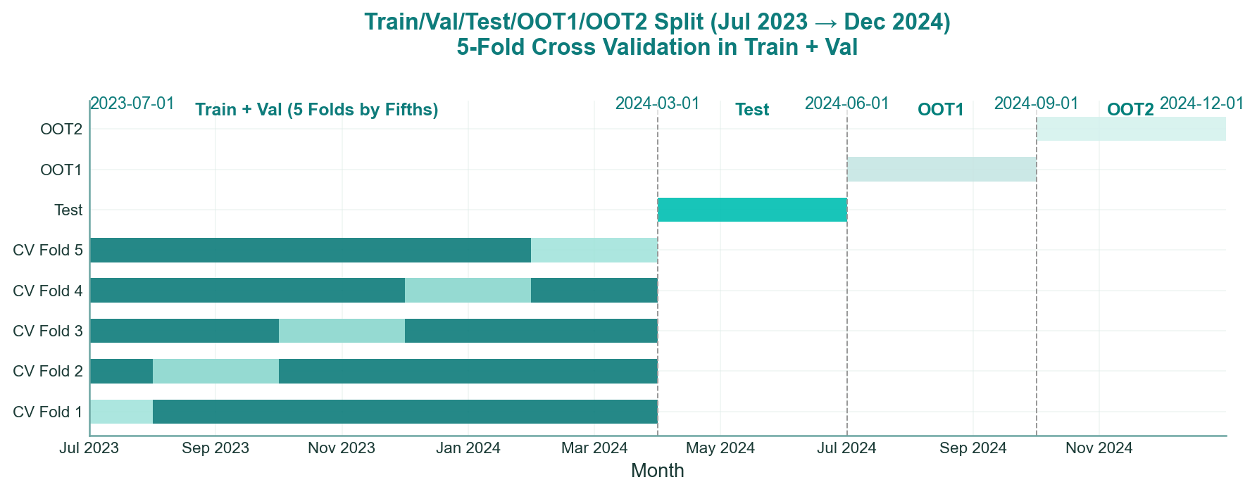
Data Splitting Strategy
Temporal data splits ensure sufficient tuning data and independent validation windows, enabling robust evaluation and confidence in model performance and inference stability before deployment.
5 fold cross validation used for more accurate estimation of model performance for each hyperparameter trial
Robust train/test/OOT split to ensure confidence in model performance & deployment
Dataset | Period | Purpose / Usage | Description
Train / Val | Jul 2023 – Mar 2024 | Model training, tuning, and feature selection | Used to train models and optimize hyperparameters through cross-validation.
Test | Apr 2024 – Jun 2024 | Final model evaluation | Held out for unbiased assessment of model performance before deployment.
OOT 1 | Jul 2024 – Sep 2024 | Out-of-time validation | Simulates model behavior on unseen, time-shifted data to check temporal stability.
OOT 2 | Oct 2024 – Dec 2024 | Production inference simulation | Represents real-world performance via the deployed inference pipeline.
Notes:
Author: Mark Nold
Website: https://marknold.substack.com
This template is intended to help future business leaders and consultants learn how to communicate better. It is available at marknold.substack.com
This template is released under Creative Commons By 4.0 Deed, which means
* You are free to Share and Adapt, but;
* You must give appropriate credit to the author and website.
eg: "Using Mark Nold’s template found at https://marknold.substack.com"
For further details on the Creative Commons By 4.0 Deed, please see https://creativecommons.org/licenses/by/4.0/

Slide 5
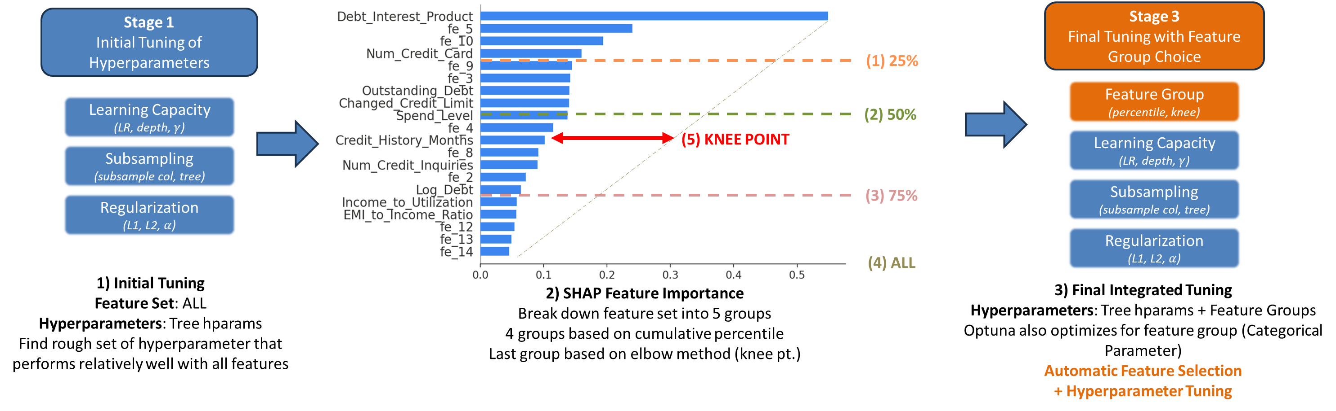
Model Training & Tuning
3-Stage Integrated Hyperparameter Tuning and Feature Selection. Enables automatic and efficient tuning of model together with feature selection. Critical since feature set will affect optimal hyperparameter and vice versa.
Productivity Gain with Automatic Hyperparameter tuning + Feature Selection
Optimality where feature set and hyperparameters are tuned concurrently
* Tuned using TreeBasedSampler in Optuna for cost-efficient hyperparameter tuning
Notes:
Author: Mark Nold
Website: https://marknold.substack.com
This template is intended to help future business leaders and consultants learn how to communicate better. It is available at marknold.substack.com
This template is released under Creative Commons By 4.0 Deed, which means
* You are free to Share and Adapt, but;
* You must give appropriate credit to the author and website.
eg: "Using Mark Nold’s template found at https://marknold.substack.com"
For further details on the Creative Commons By 4.0 Deed, please see https://creativecommons.org/licenses/by/4.0/

Slide 6
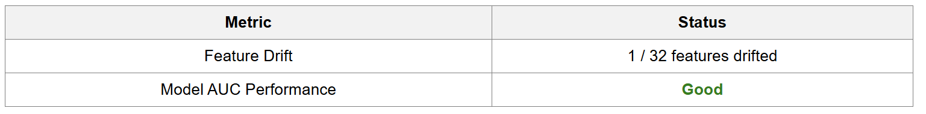
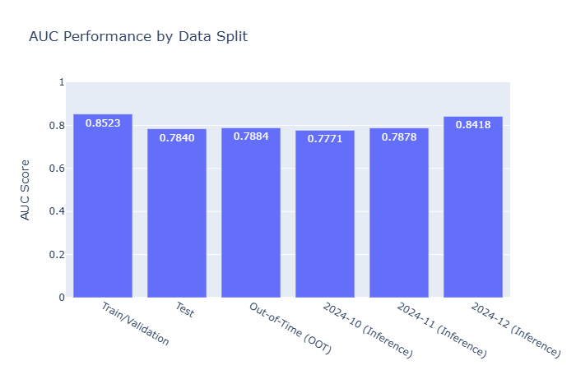
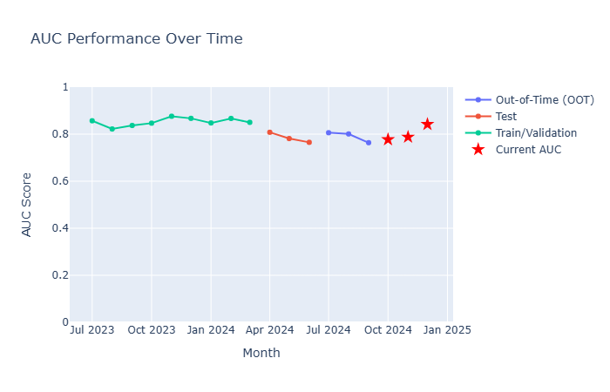
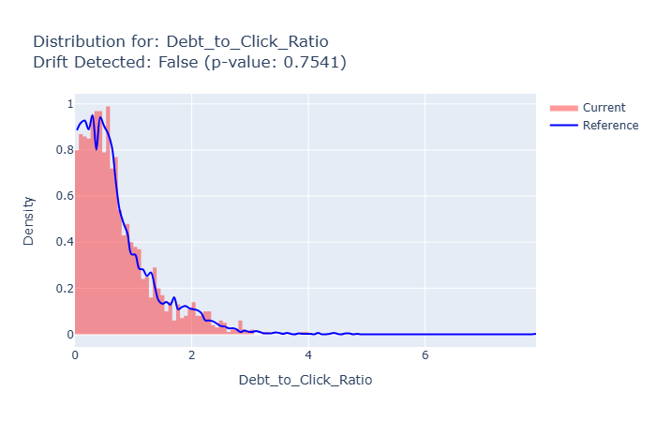
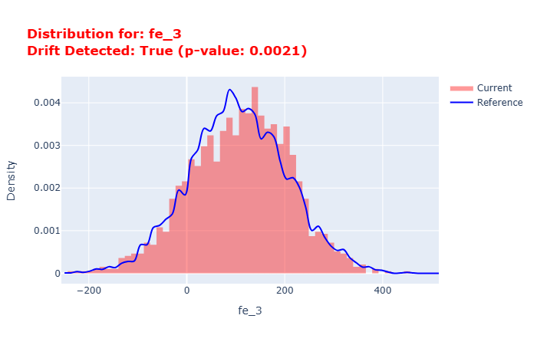
Model Monitoring
Automated monitoring of model performance and feature drift to safeguard long-term predictive integrity.
Summarized Monitoring Reports (reports/aggregated_manual/aggregated_plotly_report.html)
1
Overall Status Summary
Birds-eye view of status of inference data & model performance
2
Inference Model Performance
Compares model train, test, and OOT performance to the new inference performance
Highlights any model AUC performance degradation for investigation (3 Tiered Alert)
3
Feature Drift Comparison
Compares the input features distribution for the train, test, and OOT against the new inference data
Highlights any drift (KPSS statistical test p = 0.05) for investigation
Notes:
Author: Mark Nold
Website: https://marknold.substack.com
This template is intended to help future business leaders and consultants learn how to communicate better. It is available at marknold.substack.com
This template is released under Creative Commons By 4.0 Deed, which means
* You are free to Share and Adapt, but;
* You must give appropriate credit to the author and website.
eg: "Using Mark Nold’s template found at https://marknold.substack.com"
For further details on the Creative Commons By 4.0 Deed, please see https://creativecommons.org/licenses/by/4.0/

Slide 7
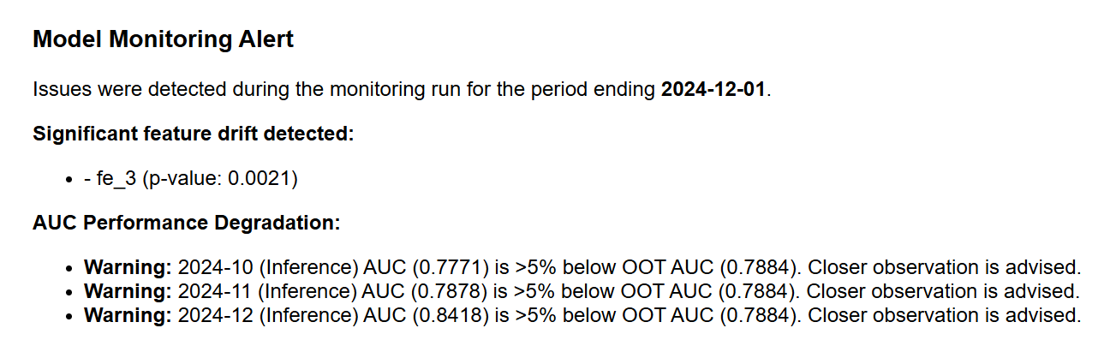
Model Governance
Automated governance framework that continuously monitors model health, detects performance degradation, and triggers tiered alerts for retraining actions.
Level | Condition (AUC Drop vs OOT) | Action
🟡 Info / Warning | ≥ 5% relative drop | Log drift event; email summary; continue monitoring next cycle
🟠 Alert / Investigate | ≥ 10% relative drop | Deep-dive diagnostics (feature drift, calibration, segment AUCs)
🔴 Critical / Retrain | ≥ 15% relative drop | Trigger model retraining & shadow test new model before promotion
Simulated email (reports/aggregated_manual/alert_simulation.html)
1
Email Alert for Feature Drift
Highlights drift in features if KPSS test significant (p<0.05). Feature plot attached at the bottom of the HTML.
2
Email Alert
Compares model train, test, and OOT performance to the new inference performance
Highlights any model AUC performance degradation for investigation (3 Tiered Alert)
*Threshold manually set to 120% for simulation purposes
Notes:
Author: Mark Nold
Website: https://marknold.substack.com
This template is intended to help future business leaders and consultants learn how to communicate better. It is available at marknold.substack.com
This template is released under Creative Commons By 4.0 Deed, which means
* You are free to Share and Adapt, but;
* You must give appropriate credit to the author and website.
eg: "Using Mark Nold’s template found at https://marknold.substack.com"
For further details on the Creative Commons By 4.0 Deed, please see https://creativecommons.org/licenses/by/4.0/

Slide 8
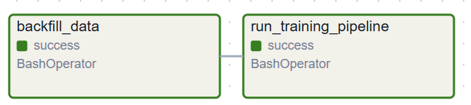
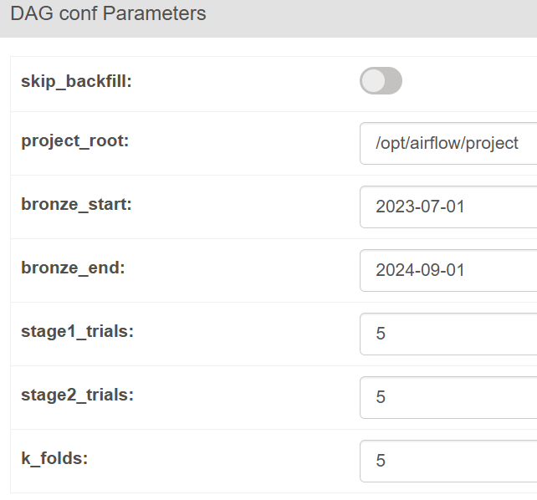
Model Training & Tuning DAG
Automated Airflow DAG orchestrating data backfill, model training, and multi-stage hyperparameter tuning for optimal model selection.
To skip data pipeline ETL
(if datamart already exists)
Project dir
Start month for ETL job
Passes selected months through bronze – silver – gold ETLs
Stores data in datamart
End month for ETL job
Number of trials for stage 1
Number of trials for stage 3
Runs 3-stage Hyperparameter Tuning + Feature Selection
Stores best model in model registry
Number of folds for train/val crossfold validation
Notes:
Author: Mark Nold
Website: https://marknold.substack.com
This template is intended to help future business leaders and consultants learn how to communicate better. It is available at marknold.substack.com
This template is released under Creative Commons By 4.0 Deed, which means
* You are free to Share and Adapt, but;
* You must give appropriate credit to the author and website.
eg: "Using Mark Nold’s template found at https://marknold.substack.com"
For further details on the Creative Commons By 4.0 Deed, please see https://creativecommons.org/licenses/by/4.0/

Slide 9
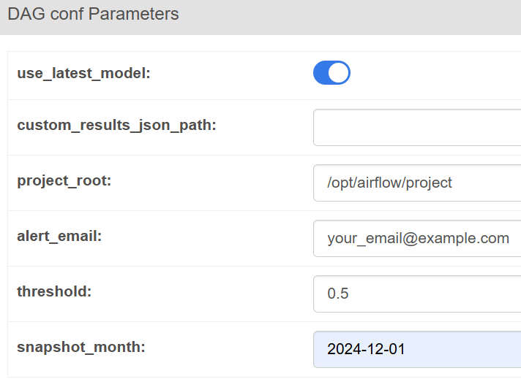
Model Inference, Monitoring, & Governance DAG
Automated Airflow DAG orchestrating model inference, performance monitoring, and governance alerts for continuous production assurance.
Selector to choose latest model for inference (or manual input)
Simluated alert email
If manual input, enter model dir here
Classification threshold
Project root dir
Inference month to run
(Use 2024-12-01 for demo)
Pick the latest tuned model (or any manual user-input model path)
Pass new snapshot months through bronze – silver – gold ETL
Then pass to model for inference
Dynamic task generation based on number of snapshot months for inference
Aggregate predictions results from various inference months into a single dataframe
Generate simulated email alert HTML report with alert and attaches relevant plots
3 Level Alert Structure
Process the snapshot months to run inference on based on user-input
Evaluate predictions against actual labels Calculate AUC
Generate plotly HTML monitoring report
Overall Summary
Model AUC performance trend
Feature Drift Monitoring
Notes:
Author: Mark Nold
Website: https://marknold.substack.com
This template is intended to help future business leaders and consultants learn how to communicate better. It is available at marknold.substack.com
This template is released under Creative Commons By 4.0 Deed, which means
* You are free to Share and Adapt, but;
* You must give appropriate credit to the author and website.
eg: "Using Mark Nold’s template found at https://marknold.substack.com"
For further details on the Creative Commons By 4.0 Deed, please see https://creativecommons.org/licenses/by/4.0/

Slide 10

Conclusion
A production-ready, end-to-end ML pipeline delivering robust, tuned, and continuously monitored
models for accurate and governed
credit-risk prediction.
End-to-end automation across data, model, and monitoring pipelines.
Robustly 3-Stage Tuned XGBoost model delivering higher accuracy and stability.
Governed, scalable deployment with automated drift alerts and retraining.
Notes:
Author: Mark Nold
Website: https://marknold.substack.com
This template is intended to help future business leaders and consultants learn how to communicate better. It is available at marknold.substack.com
This template is released under Creative Commons By 4.0 Deed, which means
* You are free to Share and Adapt, but;
* You must give appropriate credit to the author and website.
eg: "Using Mark Nold’s template found at https://marknold.substack.com"
For further details on the Creative Commons By 4.0 Deed, please see https://creativecommons.org/licenses/by/4.0/

